Slide 1
LEA Training Template
This template was developed by the North Carolina Homeless Education Program (NCHEP) to assist LEAs in creating and conducting internal staff training.
Under federal law, homeless liaisons are required to provide professional development to LEA staff members to raise awareness of the McKinney-Vento Act and students experiencing homelessness.
Keep in mind, this PPT is a template. Homeless liaisons should follow the instructions and suggestions throughout the template to develop an impactful internal staff training tailored to their audience.

Slide 2
Instructions
Transfer this information onto your district/school slides.
All highlighted sections are suggestions and should be adjusted to reflect specific information about your LEA. DO NOT leave highlighted sections in your final presentation.
Make it your own! Include information that is relevant to your homeless education program.
Tailor this training to the audience. Some staff may need additional information than what is shared in this template.
Keep accurate documentation of who was trained and when (i.e., agendas, sign-in sheets, copy of presentation, etc.).

Slide 3
The McKinney-Vento Act:
Supporting Students
Experiencing Homelessness
(LEA Name)
(Audience)
(Presenter’s Name)
(Presenter’s Title)
(Date)

Slide 4
Agenda
Overview of McKinney-Vento Act
Definition of Homeless
Causes & Impact of Homelessness
Homeless Liaison Responsibilities
Rights of Students Experiencing Homelessness
Potential Signs of Homelessness
Data Review
Internal Procedures
Include additional information you would like to cover (i.e., Title I, Transportation, Early Education, Higher Education, etc.)

Slide 5
Interactive Activity
Consider starting your presentation with an activity that prepares your audience for the topic of homelessness and the impact it can have on students.
Examples:
An icebreaker (whole group or smaller groups)
Prompted “turn and talk” discussion
Play a short video

Slide 6



The McKinney-Vento Act
The McKinney-Vento Act is a federal law that supports students experiencing homelessness through:
Federal law supersedes local and state policies and laws.
Enrollment Attendance Academic Success

Slide 7
McKinney-Vento Definition of Homeless
Individuals who lack a fixed, regular, and adequate nighttime residence.
Fixed: A residence that is stationary, permanent, and not subject to change.
Regular: A residence that is used on a regular basis ( i.e., nightly).
Adequate: Is sufficient for meeting the physical and psychological needs typically met in home environments.

Slide 8

Possible Homeless Situations
Sharing a home due to loss of housing or economic hardship
Living in motels/hotels
Living in a shelter
Living in cars/parks/under bridges
Living in campgrounds/abandoned buildings
Unaccompanied homeless youth
Other

Slide 9
Unaccompanied Homeless Youth
A youth who is not in the physical custody of a parent or guardian
AND
lacks fixed, regular, and adequate nighttime residence
Homeless
Unaccompanied
Unaccompanied Homeless Youth

Slide 10

Causes of Homelessness
Lack of Affordable Housing
Poverty
Addiction Disorders, Mental Illness
Lack of Health Insurance
Health Problems
Domestic Violence
Natural and Other Disasters
Abuse/Neglect/Family Dysfunction
Other

Slide 11

Impact on Student’s Learning
Chronic Illness
Depression
Anxiety
Reduced Engagement
Poor Attendance
Delayed Social Skills
Academic Challenges
Higher Risk of Dropout
Other

Slide 12

Homeless Liaison Responsibilities
Identification
Enrollment
Access to Services
Referrals
Parent Information
Disputes
Transportation Services
Professional Development
Collaboration
Data Collection
Other

Slide 13
Rights of Students Experiencing Homelessness
Receive a free, appropriate public education.
Enroll in school immediately, even if lacking documents required for enrollment.
Continue attending the school of origin or enroll in the school of residence.
Receive transportation to and from the school of origin, if requested.
Receive educational services comparable to those provided to other students, according to each student’s needs.
Participate in extracurricular activities.
Qualify for free school meals.

Slide 14
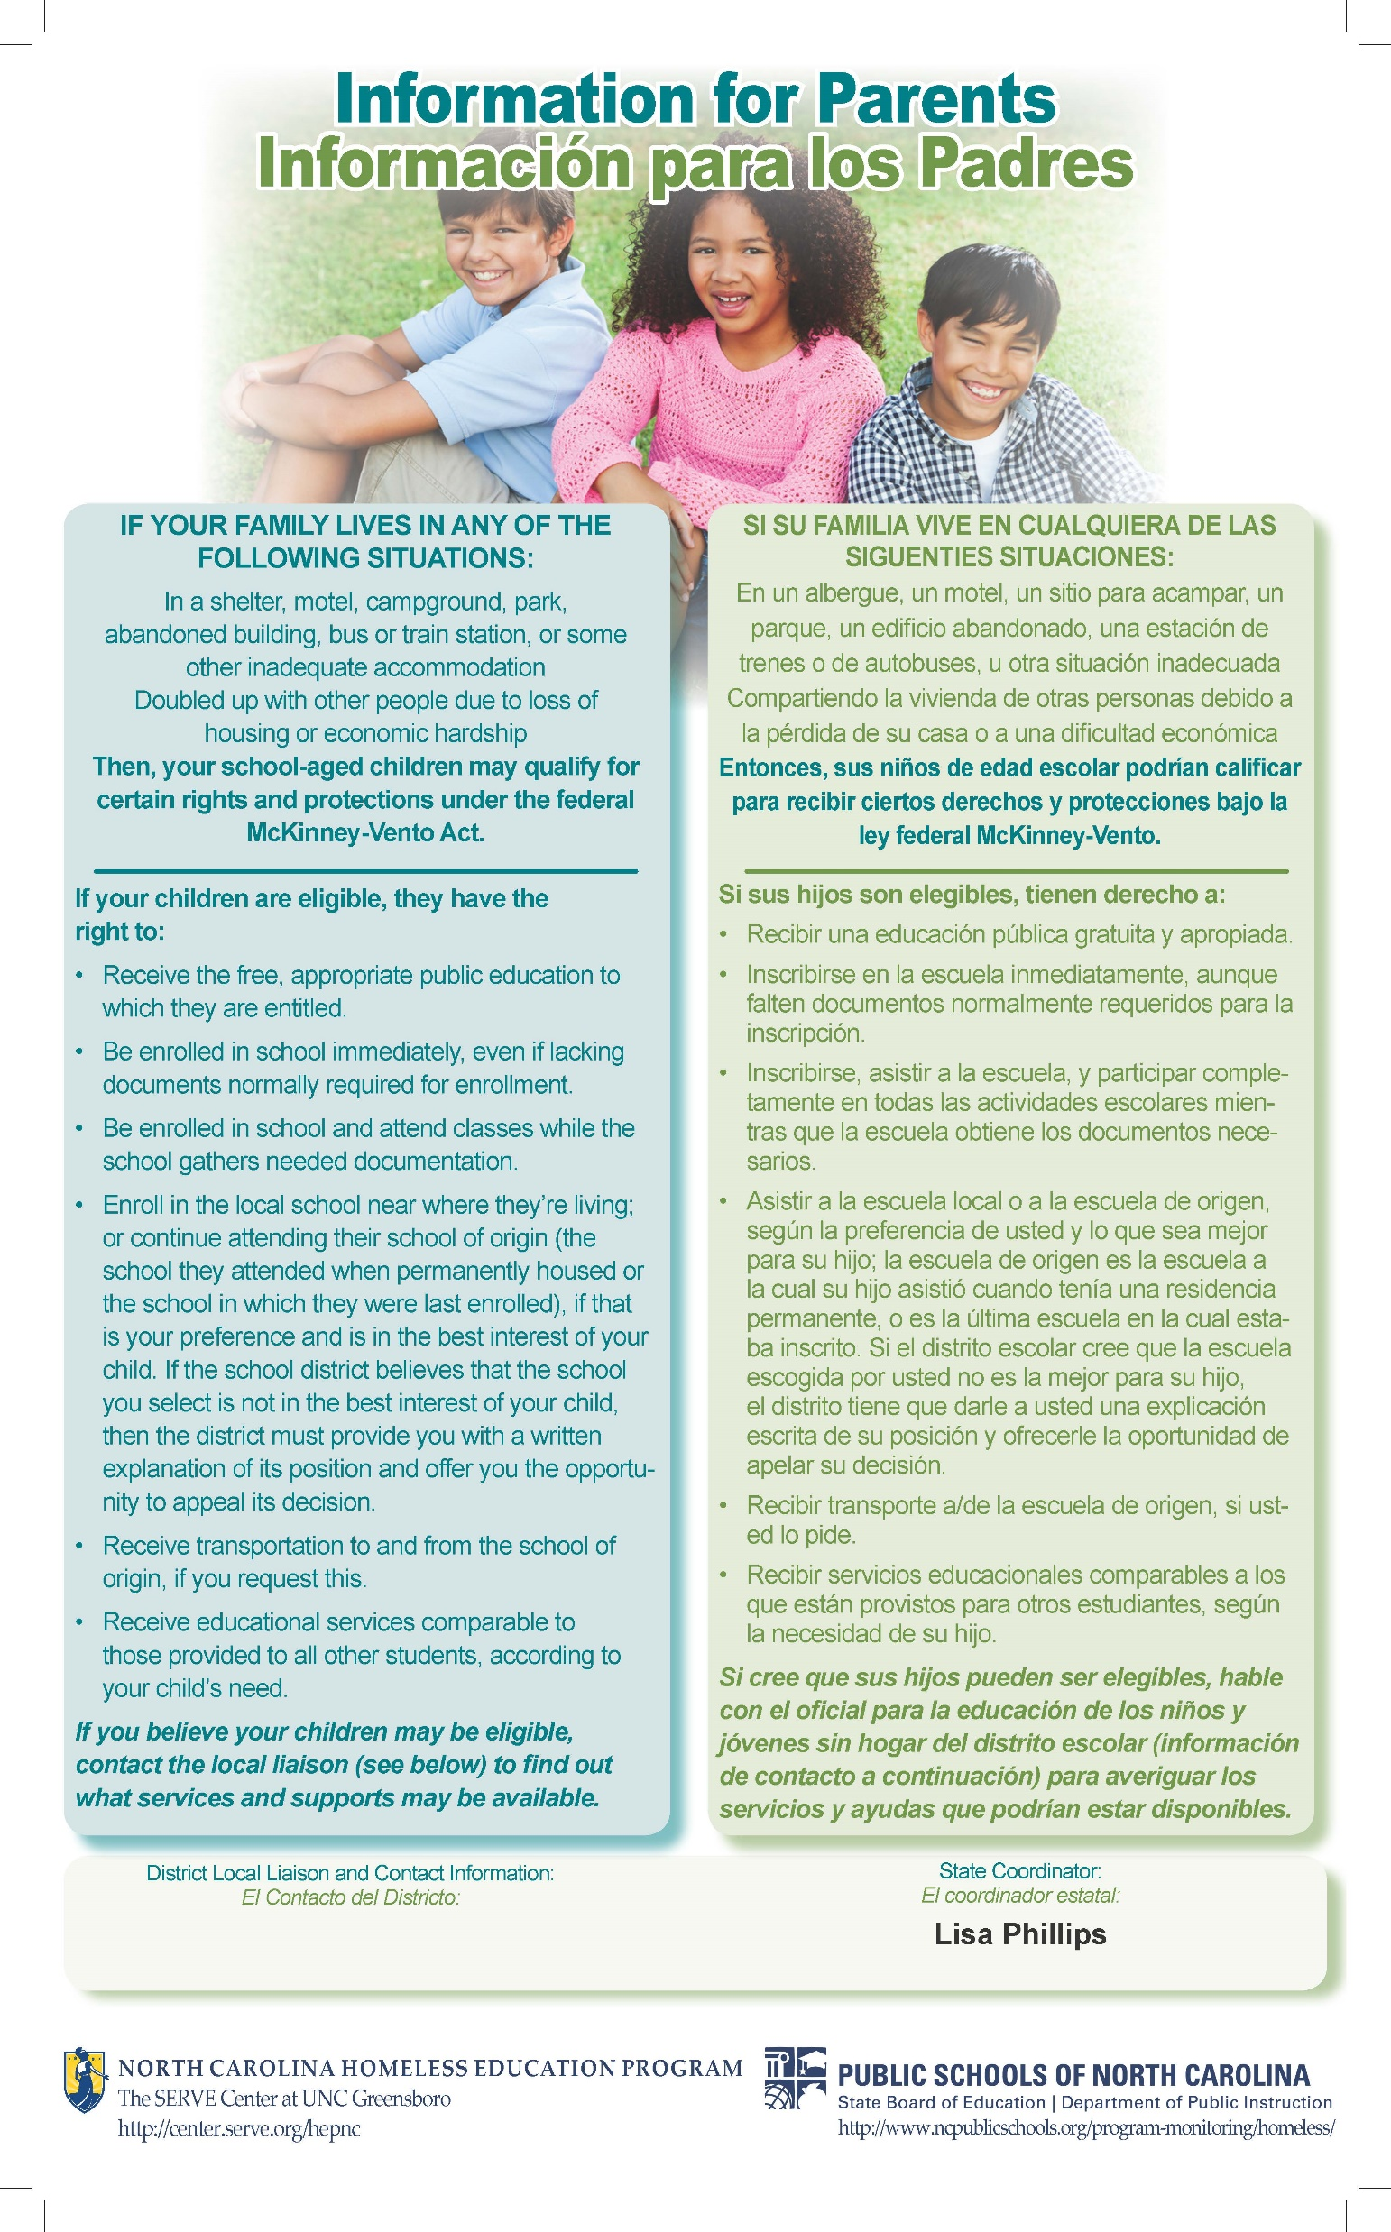
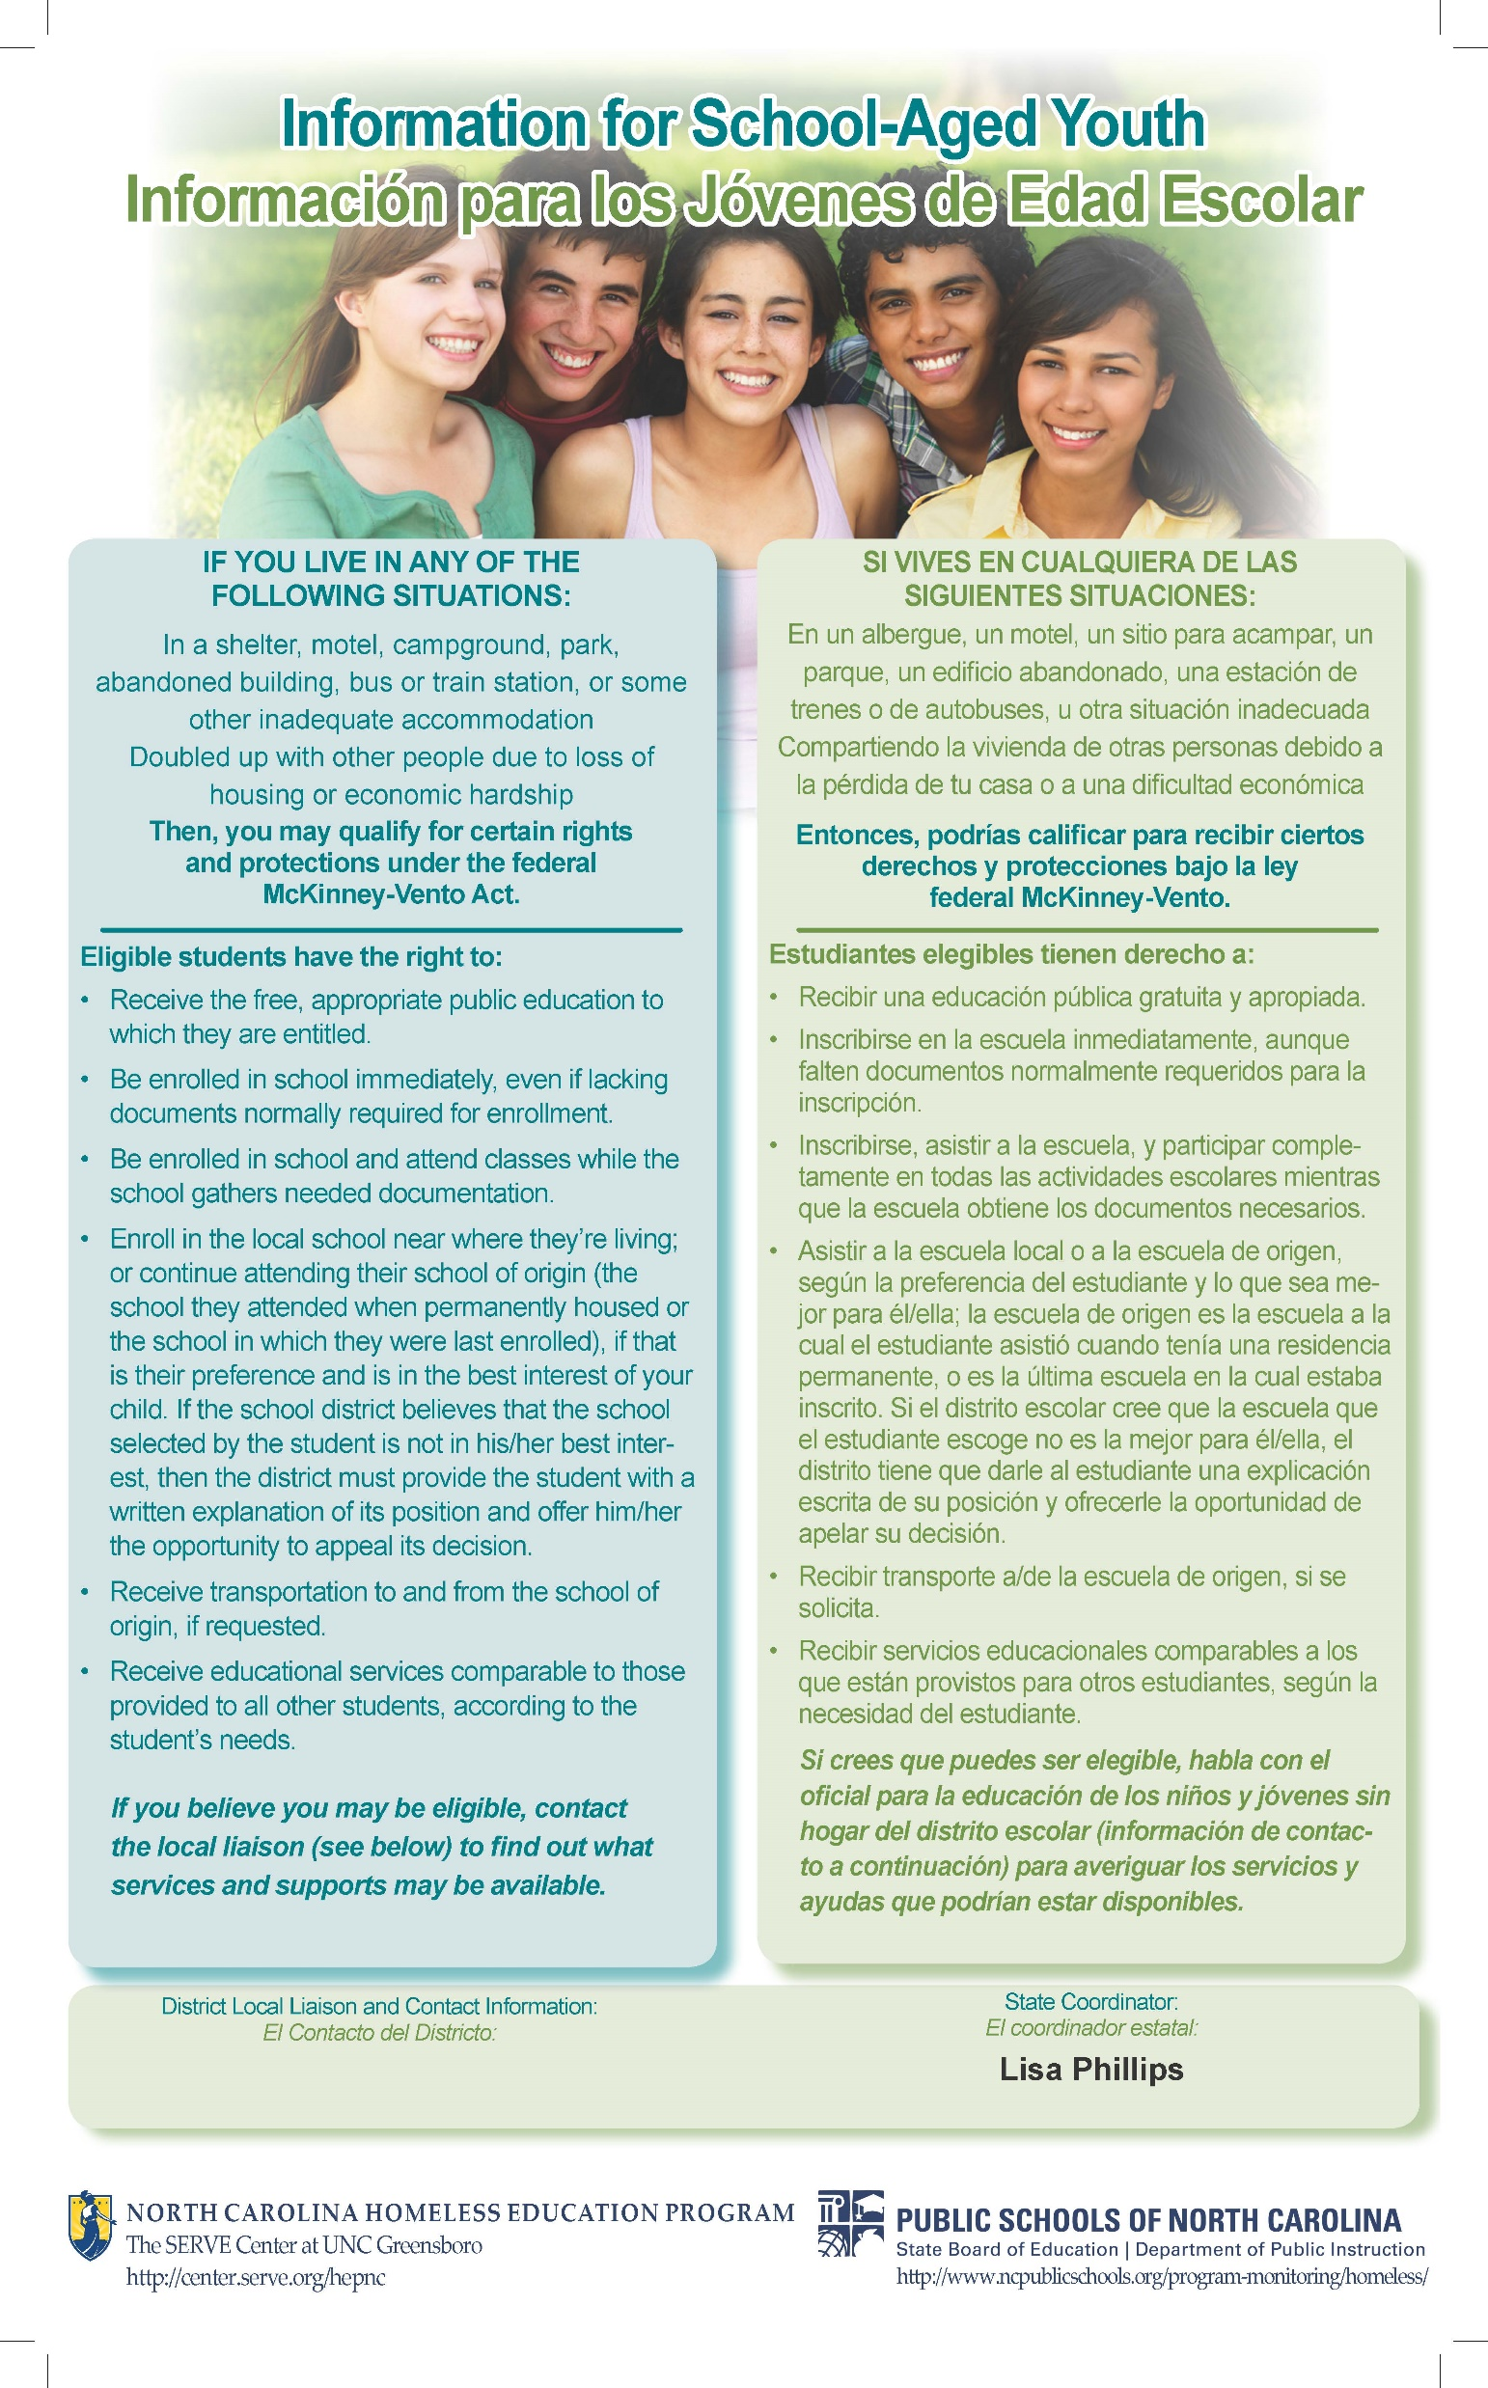
Consider sharing NCHEP’s poster for students and parents. Explain how they should be posted in each school building and in the community to build awareness.

Slide 15

Support for Students
School Meals
Early Education for Preschoolers
Extracurricular Activities
Credit Accrual
Supportive Discipline
Postsecondary Education
FAFSA Completion

Slide 16

Transportation
To and from the “school of origin”
Requested by parent, guardian, or unaccompanied homeless youth
Prompt provision
LEA determines the mode of transportation
Coordination between neighboring LEAs

Slide 17
Potential Signs of Homelessness
Lack of Educational Continuity
Poor Health/Nutrition
Tiered/ Falling Asleep in Class
Transportation & Attendance Problems
Lack of School Supplies
Poor Hygiene
Lack of Personal Space After School
Social and Behavioral Concerns
Reactions or Statements by Parents, Guardians, or Students
Note: While these are considered common signs, please recognize that they only offer general guidance.
Consider sharing NCHEP’s Common Signs of Homelessness

Slide 18
Data Review
Include information (graphs/charts) with district, community, and state homeless data.
Examples:
Number of students identified by your LEA in previous school years
Number of UHY identified by your LEA in previous school years
Number of 0-5 aged siblings identified by your LEA in previous school years
Academic performance of those identified
Local poverty rate
Statewide homeless data from NCHEP

Slide 19
Data Collection
Collecting and submitting data on students experiencing homelessness is a requirement of every LEA, even if there are zero students to report.
Data collection helps with…
Local, state, and national decisions regarding homeless education programs
Assessing the needs of your students experiencing homelessness
Evaluating the effectiveness of the supports that are in place for these students
Supporting potential funding opportunities

Slide 20
Internal Procedures
Use a few slides to explain your LEA’s internal procedures if staff suspect a student is experiencing homelessness.
Examples:
Who is their point of contact at the school/district level?
When should staff make a referral about a student?
How does staff refer a student they have concerns about?

Slide 21

Questions

Slide 22
Contact Information
Include contact information for the LEA’s homeless liaison
Include additional school or district-level contacts as appropriate

Slide 23
Local Resources
Include a link to LEA’s McKinney-Vento webpage *it is a requirement to have information about the McKinney-Vento Act on your LEA website*
Include any local resources you would like to share.
Examples:
Continuum of Care (CoC) / Balance of State (BoS)
Local shelters
Local DSS agency
Food pantries

Slide 24
State & National Resources
The McKinney-Vento Act
North Carolina Homeless Education Program (NCHEP)
National Center for Homeless Education (NCHE)
Education for Homeless Children and Youths Program: Non-Regulatory Guidance
SchoolHouse Connection

Slide 25
Additional Resources
The following resources can be used to help develop your presentation.
NCHEP Training Templates (i.e., North Carolina Data Slides)
NCHEP’s Common Signs of Homelessness
Videos:
Caring Schools Make the Difference – NC
Homeless Liaisons Navigate Challenges in North Carolina
HEAR US: Understand Homelessness
NCDPI: Data Reports

