Slide 1

North Carolina Data Slides for Homeless Liaison Use Created November 2025

Slide 2
North Carolina Data Slides
These slides may be used when providing training and awareness presentations.
Providing a comparison of local data and state data is a good way to help stakeholders understand and gauge the identifications and needs of the local homeless education program.
Tables, charts, and graphs are useful in organizing and visualizing data to make it easier to understand.

Slide 5
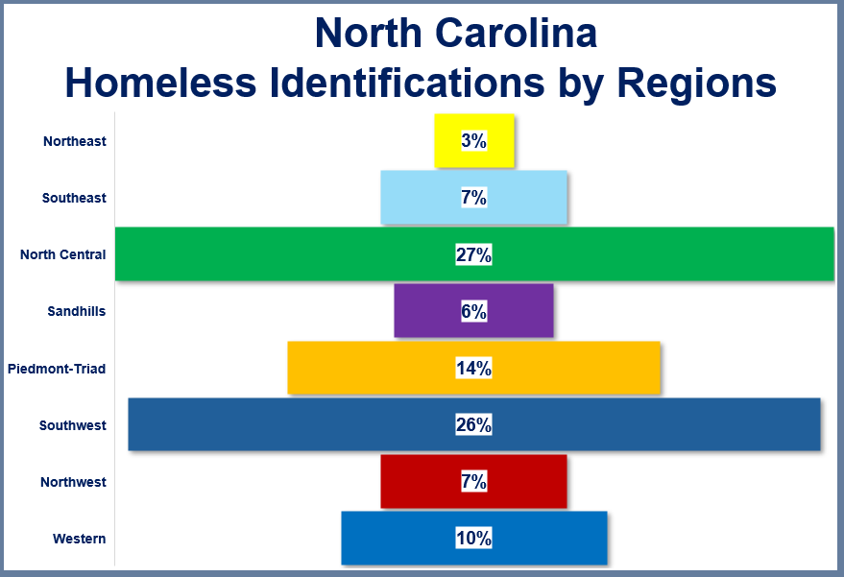

Slide 8



Creating Slides Using Your Data
Choose “Insert” in the toolbar
In the Illustrations section, choose “Chart”
Choose the type of chart you would like to insert
Once the chart is chosen, an Excel sheet will appear for data to be entered into
You can edit the chart by choosing:
Chart elements
Styles
Data

Slide 9
Homeless Data Resources
North Carolina Department of Public Instruction
US Department of Education
National Center for Homeless Education
SchoolHouse Connection Data Profiles

